Slide 1
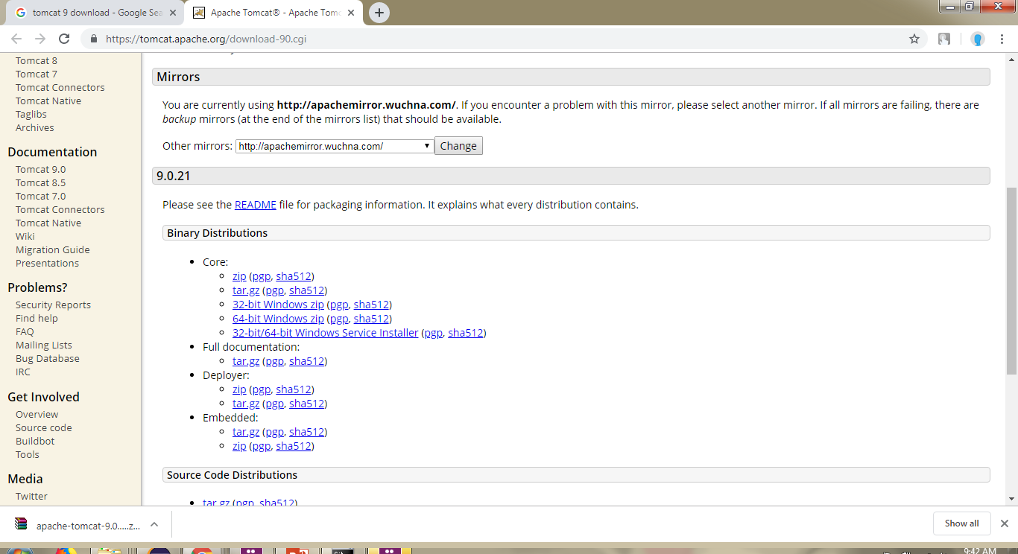
Tomcat 9 Installation
https://tomcat.apache.org/download-90.cgi

Slide 2
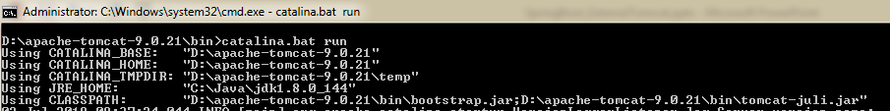
Tomcat 9 Installation
catalina.bat run

Slide 3
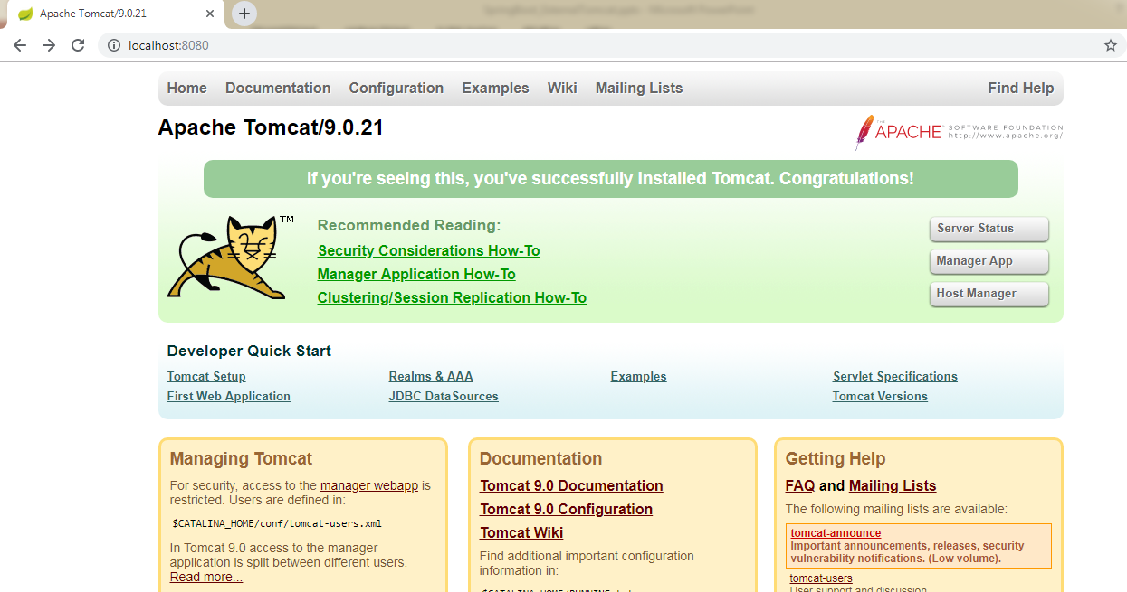
Tomcat 9 Installation
http://localhost:8080/

